Slide 1
5 PARTS TO THE PERFECT PARAGRAPH
TOPIC SENTENCE
EXTEND THE ARGUMENT
EVIDENCE
APPLY EVIDENCE
TRANSITION
Digital technology is contributing to alarming rates of narcissism. Everywhere one looks today, they can most likely find people updating their statuses, shooting pictures of their gourmet dishes, and taking selfies. People are constantly posting on their social media platforms in order to garner attention from their so-called “friends” and “followers.” This has gotten so out of hand, one study concludes that, “The incidence of narcissistic personality disorder is nearly three times as high for people in their 20s as for the generation that's now 65 or older” (Stein 26). In other words, there is data to prove a troubling generational shift in rates of narcissism. Not only is digital technology leading to higher rates of narcissism, but it is also hurting people’s ability to communicate with one another.

Slide 2
5 PARTS TO THE PERFECT PARAGRAPH
TOPIC SENTENCE (1 sentence): Make an argument, claim, state a position, problem, objective/solution.
EXTEND THE ARGUMENT (1-2 sentences): Elaborate on the argument, claim, position, problem, objective, or solution you mentioned in the topic sentence.
EVIDENCE (3 lines of text or less): Provide evidence that corroborates your argument, claim, position, problem, objective, or solution.
APPLY EVIDENCE (1-2 sentences): Summarize or further explain your evidence.
TRANSITION (1-2 sentences): Wrap up your argument, claim, position, problem, objective, or solution and transition into the next topic sentence (your next argument).

Slide 3
TOPIC SENTENCE
Digital technology is contributing to alarming rates of narcissism.

Slide 4
EXTEND THE ARGUMENT
Everywhere one looks today, they can most likely find people updating their statuses, shooting pictures of their gourmet dishes, and taking selfies. People are constantly posting on their social media platforms in order to garner attention from their so-called “friends” and “followers.”

Slide 5
EVIDENCE
This has gotten so out of hand , one study concludes that, “The incidence of narcissistic personality disorder is nearly three times as high for people in their 20s as for the generation that's now 65 or older” (Stein 26).

Slide 6
APPLY EVIDENCE
In other words, there is data to prove a troubling generational shift in rates of narcissism.

Slide 7
TRANSITION
Not only is digital technology leading to higher rates of narcissism, but it is also hurting people’s ability to communicate with one another.

Slide 8
LEARN TO TRANSITION YOUR PARAGRAPHS
When writing a paragraph or a larger piece of writing, you can covertly transition your thoughts to show the reader the logical relationship between one group of sentences and another group of sentences.
This is useful when you want to let the reader know that you are changing from one idea to another idea.

Slide 9
LEARN TO TRANSITION YOUR PARAGRAPHS
When writing a paragraph or a larger piece of writing, you can covertly transition your thoughts to show the reader the logical relationship between one group of sentences and another group of sentences.
This is useful when you want to let the reader know that you are changing from one idea to another idea.

Slide 10
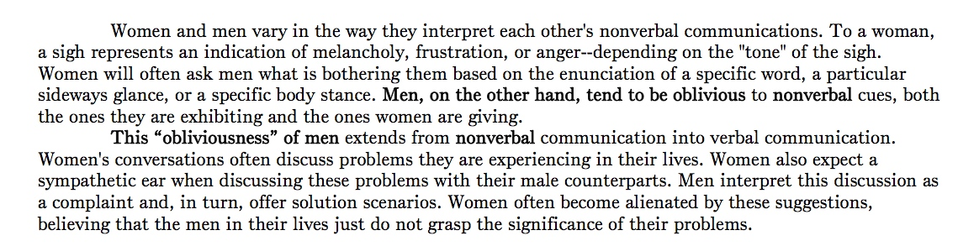
TRANSITIONS: PARAGRAPH LEVEL

Slide 11
TRANSITIONAL DEVICES
Nonetheless,
However,
Therefore,
For example,
Additionally,
Consequently,
In other words,
To this end,

Slide 12
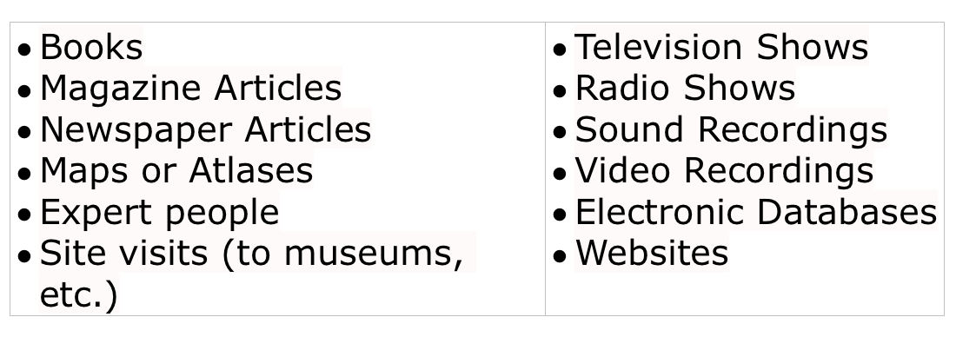
TITLES OF SOURCES
How do I know what titles go in italics and what titles go in quotation marks?

Slide 13
COMPLETE WORKS GET ITALICIZED
The titles of the following types of material should be italicized when you refer to them in the text of your paper or in your bibliography:
books
plays
long poems published as books
pamphlets
periodicals (newspapers, magazines, and journals)
films (including documentaries i.e. Frontline: Digital Nation)
radio and television programs
CDs, tapes, or record albums
ballets
operas or other long musical compositions
paintings and sculptures
ships, aircrafts, and spacecraft

Slide 14
SHORTER WORKS GET QUOTATION MARKS
articles
essays within a larger collection
short stories
short poems included in a larger collection
chapters of books
individual episodes of TV and radio programs
songs and similar short musical compositions
unpublished works such as lectures, conference presentations, manuscripts and dissertations

Slide 15
USING EVIDENCE IN ACADEMIC WRITING
Let’s pretend that you’re making an argument about how social media makes people more antisocial, and you’ve found the perfect quote from our one of our readings or documentaries to support this argument;
Source: Dr. Larry Smith is a clinical psychologist at the University of Nevada
Quote: “Our studies show that people on their phones all the time do a lot less communicating face to face.”
Citation Info: Page 5 of an article by Henry Pearsall titled “Technology and the Brain”

Slide 16
RULE #1: DROP QUOTES ARE NO NO!
YOU MUST HAVE YOUR OWN IN THE SAME SENTENCE IN WHICH YOU INTRODUCE THE QUOTE
NEVER use a drop quote. A drop quote is when you just drop a quote into the text without properly setting it up (see example below).
Example: There is a lot of evidence to prove that technology is making younger people more antisocial. “Our studies show that people on their phones all the time do a lot less communicating face to face.”

Slide 17
RULE #2: TRY INTRODUCING THE SOURCE OF THE QUOTE
When setting up a quotation, give the author’s name and give them authority by mentioning his or her credentials. Also, be sure to put the author and page # from where you got the source in parentheses at the end of the quote
Example: In “Technology and the Brain,” Dr. Larry Smith, a clinical psychologist at the University of Nevada, explains, “Our studies show that people on their phones all the time do a lot less communicating face to face” (Pearsall, 5).

Slide 18
RULE #3: TRY EMBEDDING THE QUOTE INTO YOUR OWN SENTENCE
You don’t necessarily have to mention the author and give them authority every time you quote them. In fact, if you quote them more than once, there is no reason to reintroduce them to your reader, as this would be redundant. Instead, try embedding the quote into your own sentence. You can remove words at the beginning, in the middle, or at the end of a sentence and replace them with ellipses.
Example: In fact, there have been a number of studies indicating “. . . that people on their phones all the time do a lot less communicating face to face” (Pearsall, 5).

Slide 19
QUOTATIONS REMINDERS
Approximately 5 quotations in a 750 words paper
Quotations should NEVER run more than four lines of text
NEVER use a drop quote. Quotes must always be introduced or embedded into your own sentence
Quotes should often be introduced by lending authority to the source (explaining their credentials).
Quotes should have a parenthetical citation at the end.
NEVER begin nor end a body paragraph with a quote. Also, do not quote in the second sentence of a paragraph. Instead, quote in the forth or fifth sentence.

Slide 20
RULE #1: DROP QUOTES ARE NO NO!
YOU MUST HAVE YOUR OWN IN THE SAME SENTENCE IN WHICH YOU INTRODUCE THE QUOTE
NEVER use a drop quote. A drop quote is when you just drop a quote into the text without properly setting it up (see example below).
Example: There is a lot of evidence to prove that technology is making younger people more antisocial. “Our studies show that people on their phones all the time do a lot less communicating face to face.”

Slide 21
RULE #2: TRY INTRODUCING THE SOURCE OF THE QUOTE
When setting up a quotation, give the author’s name and give them authority by mentioning his or her credentials. Also, be sure to put the author and page # from where you got the source in parentheses at the end of the quote
Example: In “Technology and the Brain,” Dr. Larry Smith, a clinical psychologist at the University of Nevada, explains, “Our studies show that people on their phones all the time do a lot less communicating face to face” (Pearsall, 5).

Slide 22
RULE #3: TRY EMBEDDING THE QUOTE INTO YOUR OWN SENTENCE
You don’t necessarily have to mention the author and give them authority every time you quote them. In fact, if you quote them more than once, there is no reason to reintroduce them to your reader, as this would be redundant. Instead, try embedding the quote into your own sentence. You can remove words at the beginning, in the middle, or at the end of a sentence and replace them with ellipses.
Example: In fact, there have been a number of studies indicating “. . . that people on their phones all the time do a lot less communicating face to face” (Pearsall, 5).

Slide 23
LEARN TO SPLIT THE QUOTATION IN THE MIDDLE
Michelle Saffla, a former administrator at the Environmental Protection Agency, explains: “The problem with multinational corporation’s practice of outsourcing is that they often exploit foreign workers while delivering a blowing crush to American jobs” (189).
“The problem with multinational corporation’s practice of outsourcing,” explains Michelle Saffa, a former administrator at the Environmental Protection Agency, “is that they often exploit foreign workers while delivering a blowing crush to American jobs” (189).

Slide 24
QUOTATIONS REMINDERS
Approximately 5 quotations in a 750 words paper
Quotations should NEVER run more than four lines of text
NEVER use a drop quote. Quotes must always be introduced or embedded into your own sentence
Quotes should often be introduced by lending authority to the source (explaining their credentials).
Quotes should have a parenthetical citation at the end.
NEVER begin nor end a body paragraph with a quote. Also, do not quote in the second sentence of a paragraph. Instead, quote in the forth or fifth sentence.

