Slide 1


Slide 2
ARE GUN-RELATED DEATHS A PROBLEM IN AMERICA?

Slide 3
GUNS IN AMERICA
Estimates show that there are over 300 million firearms in the U.S. (America has more guns than people). 3% of gun owners account for owning 150 million of those guns (with collections that rate from 8 to 140).
Some estimates show that America’s gun homicide rate is more than 25 times the average of other high-income countries.

Slide 4
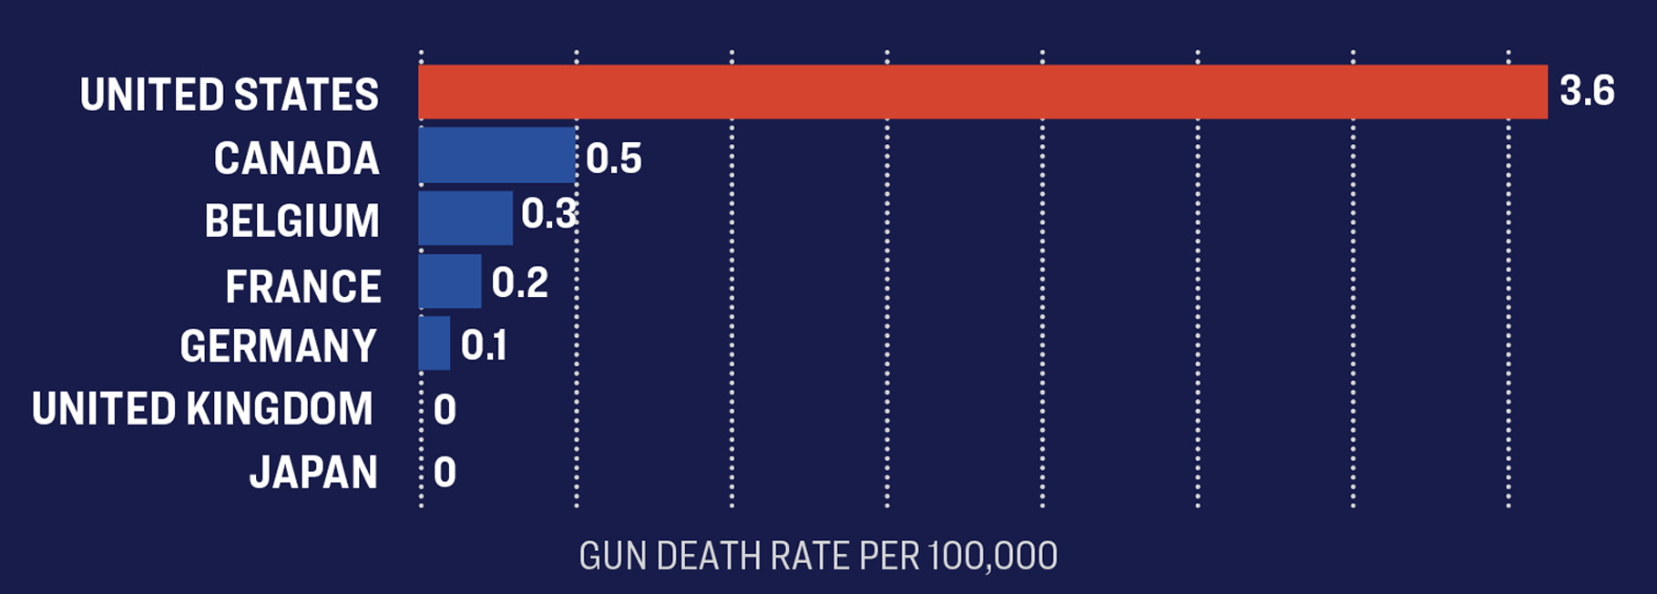

Slide 5
DAILY GUN VIOLENCE IMPACTING PEOPLE OF ALL AGES IN THE U.S.
Every day, 310 people are shot in the United States. Among those:
100 people are shot and killed
210 survive gun injuries
95 are injured in an attack
61 die from suicide
10 survive a suicide attempt
1 is killed unintentionally
90 are shot unintentionally
1 is killed by legal intervention
4 are shot by legal intervention
1 died but the intent was unknown
12 are shot but the intent was unknown

Slide 6
DAILY GUN VIOLENCE IMPACTING CHILDREN AND TEENS (1-17)
Every day, 21 children and teens (1-17) are shot in the United States. Among those:
4 die from gun violence
2 are murdered
17 children and teens survive gun injuries
8 are injured in an attack
2 children and teens either die from suicide or survive a suicide attempt
8 children and teens are shot instances of family fire — a shooting involving an improperly stored or misused gun found in the home resulting in injury or death

Slide 7
ANNUAL GUN VIOLENCE IMPACTING PEOPLE OF ALL AGES IN THE U.S.
Every year, 113,108 people are shot. Among those:
36,383 people die from gun violence
12,830 are murdered
76,725 people survive gun injuries
34,566 are injured in an attack
22,274 die from suicide
3,554 survive a suicide attempt
496 are killed by legal intervention
1,376 are shot by legal intervention
295 die but the intent was unknown
4,471 are shot but the intent is unknown
509 women are killed by their husband or male dating partner*

Slide 8
ANNUAL GUN VIOLENCE IMPACTING CHILDREN AND TEENS (AGES 1-17)
Every year, 7,782 children and teens are shot in the United States. Among those:
1,488 children and teens die from gun violence
772 are murdered
6,294 children and teens survive gun injuries
2,788 injured in an attack
590 die from suicide
166 survive a suicide attempt
86 are killed unintentionally
2,893 are shot unintentionally
30 die but the intent was unknown
380 are shot but the intent is unknown

Slide 9
GUNS & SUICIDE
Nearly two-thirds of gun deaths are suicides. The U.S. gun suicide rate is 10 times that of other high-income countries.
Access to a gun increases the risk of death by suicide by three times.
Gun suicides are concentrated in states with high rates of gun ownership.
Most people who attempt suicide do not die—unless they use a gun. Across all suicide attempts not involving a firearm, less than five percent will result in death.But for gun suicides, those statistics are flipped: approximately 85 percent of gun suicide attempts end in death.
White men represent 74 percent of firearm suicide victims in America.

Slide 10
GUNS & DOMESTIC VIOLENCE
Women in the U.S. are 21 times more likely to be killed with a gun than women in other high-income countries.
In an average month, 52 American women are shot to death by an intimate partner,and many more are injured.
Nearly one million women alive today have been shot or shot at by an intimate partner.
Approximately 4.5 million American women alive today have been threatened with a gun by an intimate partner.
Access to a gun in a domestic violence situation makes it five times more likely that a woman will be killed.
Black women are twice as likely to be fatally shot by an intimate partner compared to white women.

Slide 11
MASS SHOOTINGS
Public mass shootings account for a tiny fraction of the country’s gun deaths, but they are uniquely terrifying because they occur without warning in the most mundane places.
There is no universally accepted definition of a public mass shooting.
The Washington Post conducted a study on mass shootings using a definition in which four or more people were killed by a lone shooter. The study began in 1966. There are there numbers:
163 incidents
1,165 killed from nearly every imaginable race, religion and socioeconomic background.
313 guns used (59 obtained illegally)
Nearly 40% of major mass shootings were followed by a significant rise or fall in Americans buying guns

Slide 12
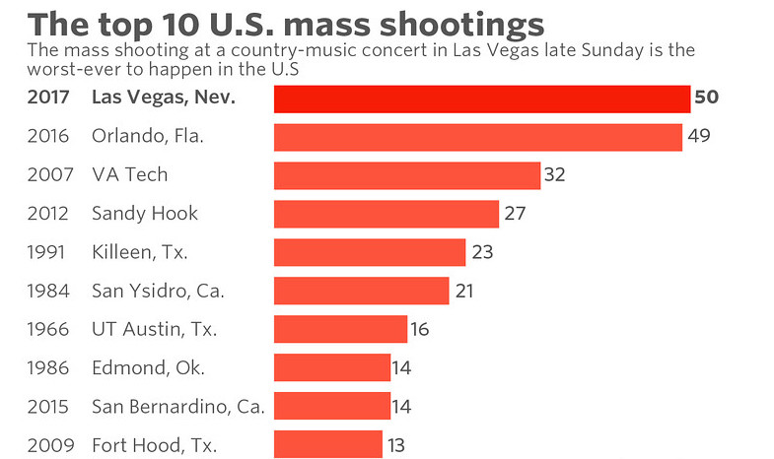

Slide 13
SCHOOL SHOOTINGS
The Columbine High School shooting on April 20th, 1999 shocked the entire nation.
Twelve students and one teacher were killed by students Dylan Klebold, 17, and Eric Harris, 18.

Slide 14
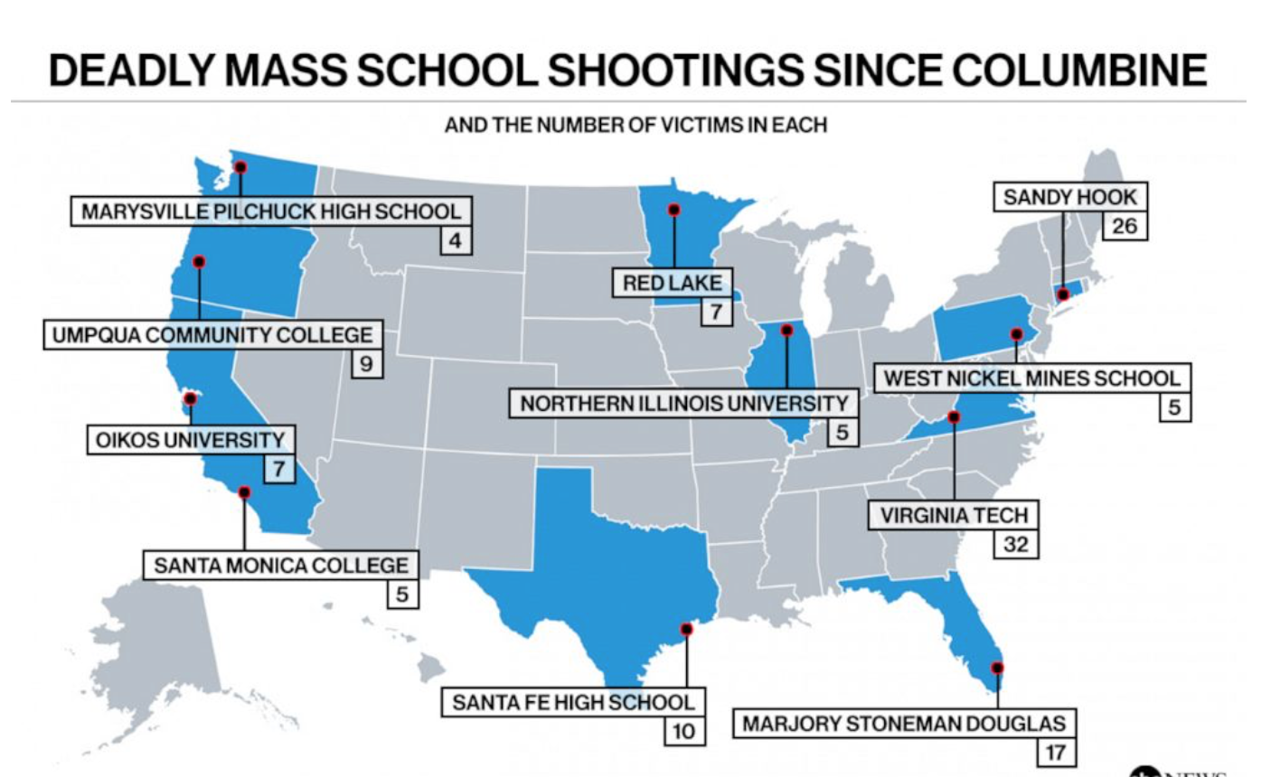

Slide 15
POST COLUMBINE
More than 228,000 students have experienced gun violence at school since Columbine.
The vast majority of K-12 schools now regularly conduct “Active Shooter Drills”

Slide 16
