Slide 1
ADVICE ON WRITING
CREATIVE NONFICTION
By David Foster Wallace
As nonfiction, the works are connected to actual states of affairs in the world, are “true” to some reliable extent. If, for example, a certain event is alleged to have occurred, it must really have occurred; if a proposition is asserted, the reader expects some proof of (or argument for) its accuracy. At the same time, the adjective creative signifies that some goal(s) other than sheer truthfulness motivates the writer and informs her work. This creative goal, broadly stated, may be to interest readers, or to instruct them, or to entertain them, to move or persuade, to edify, to redeem, to amuse, to get readers to look more closely at or think more deeply about something that’s worth their attention. . . or some combination(s) of these. Creative also suggests that this kind of nonfiction tends to bear traces of its own artificing; the essay’s author usually wants us to see and understand her as the text’s maker. This does not, however, mean that an essayist’s main goal is simply to “share” or “express herself” or whatever feel-good term you might have got taught in high school. In the grown-up world, creative nonfiction is not expressive writing but rather communicative writing. And an axiom of communicative writing is that the reader does not automatically care about you (the writer), nor does she find you fascinating as a person, nor does she feel a deep natural interest in the same things that interest you. The reader, in fact, will feel about you, your subject, and your essay only what your written words themselves induce her to feel. An advantage of the workshop format is that it will allow you to hear what other reasonably intelligent adults have been induced to think and feel about each essay you write for the course.

Slide 2
What Should I Write About?
Keep in mind that you do not necessarily have to write a personal essay. However, you should make it clear to the reader that you’re personally involved with whatever you’re writing about.
Should you attempt to write a personal narrative, keep in mind that your personal stories, while interesting, are often not enough on their own to become successful pieces of creative nonfiction. As you tell your personal narrative, you want to do the following:
1) Provide your reader with access into an unfamiliar world (cultural, socioeconomic, intellectual, psychological, historical, etc).
2) Include some basic research within the narrative (statistics, facts, figures, quotes from experts, etc). However, don’t overuse research to the point where your essay becomes a research essay (or something you’d write for an English composition course).
3) TEACH YOUR READER SOMETHING BESIDES YOUR OWN STORY

Slide 3
STUDENT ESSAYS
An essay about a time when a student was homeless.
This narrative was about a student’s experience being homeless for a two month period of his life. The essay included interesting research about homelessness in Hawaii, including statistics and a quotation from a politician who “Doesn’t believe homelessness is a problem on Oahu.” Although the essay was a narrative, it began as a letter written to this politician.

Slide 4
STUDENT ESSAYS
An essay about going through a divorce and reconvening with nature.
In this essay, the brokenhearted narrator was going through a divorce and decided to take a five day hike to get away from his difficult home life. The narrative included interesting research about the alarming divorce rate for people in his age group.

Slide 5
STUDENT ESSAYS
An essay about the word “haole.”
This essay was a story about a Hawaiian girl who was dating a white male, a “haole.” The essay told about the tension this created with certain members of her family. The essay also explored the historical significance of the world “haole” and how it has changed over the years. It also examined Hawaiian aliʻi who married haoles over the years.

Slide 6

THE VERY BASIC PRACTICES

Slide 7
GRAMMAR = CREDIBILITY
Your grammar skills, or lack thereof, reflect your credibility, or lack thereof.
If you want your work to be accepted by publishers and readers alike, your grammar must be up to par.
“Most reputable publishers have enough submissions that they can toss grammatically weak work right into the trash can without thinking twice” (Donovan).
People are often judged by the way they speak; authors are judged by the way they write.
To gain trust from your readers, you must write with proper grammar.

Slide 8
NO, NO, NO
He kissed my cheek and took my hand, we stood there watching Dawson slide over and over again every thirty seconds or so he would glance our way to make surely we were watching. The swings where near the slid so Mark and I walked over to them and each took a seat. We slowly start to swing and the metal creaked, I looked up at the sky just as the clouds floated in front of the sun. Mark and me swung for a while watching Dawson play and enjoy the cool breeze. We now had the park all to ourselves. “How has your day been so far?” Mark asked. I had a rough morning, but I am doing much better now. Dawson walked up to the swings, and climbed into the seat next to me “What made it better, besides seeing me?” Mark winked I laughed; “I just needed a little sunshine”. Dawson looked up at me and smile. “Momma, I your sunshine?” I smiled. “Yes baby you are my sunshine.” I stood up and pushed Dawson in the swing, as the sun pecked out from behind the clouds.

Slide 9
CLEAR, CONSISTENT, CONCISE
BE CLEAR
Clarity is necessary for your reader to interpret and understand your work.
BE CONSISTENT
If you make intentional stylistic choices with format, punctuation, and grammar, be consistent.
BE CONCISE
Express your message clearly without “fluffing” your work. Your work should be comprehensive, not difficult to understand.

Slide 10
INCONSISTENT TENSES WILL KILL YOUR GRADE
It was a partly cloudy day at Kapiolani Community College and I was sitting in the classroom dreaming of the weekend, pretending to listen to my professor discuss the importance of being consistent with tense. To be honest, I really didn’t care because I’m kind of a half-ass student anyway. So he looks up and says: “If you screw up your tenses, you’ll never get an A on your essay.” I look up at him and think about how wholly unfair this is. I then stare at my laptop, open my Instagram, and get back to things that really matter.

Slide 11
INCONSISTENT TENSES WILL KILL YOUR GRADE
It was a partly cloudy day at Kapiolani Community College and I was sitting in the classroom dreaming of the weekend, pretending to listen to my professor discuss the importance of being consistent with tense. To be honest, I really didn’t care because I’m kind of a half-ass student anyway. So he looks up and says: “If you screw up your tenses, you’ll never get an A on your essay.” I look up at him and think about how wholly unfair this is. I then stare at my laptop, open my Instagram, and get back to things that really matter.

Slide 12
INCONSISTENT TENSES WILL KILL YOUR GRADE
It was a partly cloud day at Kapiolani Community College and I was sitting in the classroom dreaming of the weekend, pretending to listen to my professor discuss the importance of being consistent with tense. To be honest, I really didn’t care because I’m kind of a half-ass student anyway. So he looks up and says: “If you screw up your tenses, you’ll never get an A on your essay.” I look up at him and think about how wholly unfair this is. I then stare at my laptop, open my Instagram, and get back to things that really matter.

Slide 13
FOR GOD’S SAKE
BE CONSISTENT WITH TENSE!
1) THINK about what "tense" or "time" the overall sentence is in - past, present or future.
2) LOCATE verbs (action words) in the sentence, and see what tense they are in.
3) RE-READ the sentence, to make sure you understand what it is saying.
4) RE-EXAMINE the verbs in the sentence, to make sure they are in a consistent tense.

Slide 14
TENSE: CAREFUL CONSIDERATIONS
I stood up, yawned, stretched my arms towards the sky and walked into the kitchen. “Damn it,” I said to myself. I forgot that I was out of coffee, and so I grabbed my raincoat out of the closet and headed into the morning dew. It was so cold that I saw my breath in the freezing air. I placed the key into the ignition and tried to get the engine to turn over. It was dead.

Slide 15
TENSE: CAREFUL CONSIDERATIONS
I stand up, yawn, stretch my arms towards the sky and walk into the kitchen. “Damn it,” I say to myself, remembering that I’m out of coffee. I grab my raincoat out of the closet and head into the morning dew. It’s so cold that I can see my breath in the freezing air. I place my key into the ignition, hoping the engine will turn over. It’s dead.

Slide 16
TYPES OF CREATIVE NONFICTION

Slide 17
THE PERSONAL ESSAY
A piece of writing, usually in the first person, that focuses on a topic through the lens of the personal experience of the narrator. It can be narrative or non-narrative-it can tell a story in a traditional way or improvise a new way for doing so. Ultimately, it should always be based on true, personal experience.

Slide 18
THE MEMOIR
A memoir is a longer piece of creative nonfiction that delves deep into a writer's personal experience. It typically uses multiple scenes/stories as a way of examining a writer's life (or an important moment in a writer's life). It is usually, but not necessarily, narrative.

Slide 19
THE SHORT/SHORT
A short/short is a (typically) narrative work that is concise and to the point. It uses imagery and details to relay the meaning, or the main idea of the piece. Typically it's only one or two scenes, and is like a flash of a moment that tells a whole story.

Slide 20
LITERARY JOURNALISM
Literary journalism uses the techniques of journalism (such as interviews and reviews) in order to look outside of the straight forward, objective world that journalism creates. It uses literary practices to capture the scene/setting of the assignment or the persona of the person being interviewed. It can often be narrative or heavily imagistic. Another important aspect of literary journalism is that it often stretches the idea of "objective facts" in order to better reflect real life and real people. In other words, while journalism is about being completely objective, literary journalism says that people can't be objective because they already have their own subjective views about the world. Therefore, by taking the "objectiveness" out of the journalistic process, the writer is being more truthful.

Slide 21
THE LYRIC ESSAY
The lyric essay is similar to the personal essay in that it also deals with a topic that affects the reader. However, the lyric essay relies heavily on descriptions and imagery. Lyrical suggests something poetic, musical, or flowing (in a sense). This type of piece uses a heavily descriptive, flowing tone in order to tell a story.

Slide 22
SHOW, DON’T TELL
Show, don't tell is a technique often employed in various kinds of texts to enable the reader to experience the story through action, words, thoughts, senses, and feelings rather than through the author's exposition, summarization, and description. The goal is not to drown the reader in heavy-handed adjectives, but rather to allow readers to interpret significant details in the text. The technique applies equally to nonfiction and all forms of fiction, including literature, speech, movie making, and playwriting.

Slide 23
SHOW, DON’T TELL
TELL: My brother is an interesting guy.
SHOW: My brother is 6’4, has this thick light brown hair, almost khaki colored, and a voice that sounds strikingly similar to that of Christopher Walken. He has a steadfast entrepreneurial spirit to everything he does, and always has, ever since he was a kid. My brother can sell anything. I remember when we were children, he relentlessly collected baseball cards. When he got his driver’s license, he sold his entire collection for $15k and bought a nicer car than our wealthiest neighbor. Today, he is a venture capitalist in Silicone Valley. In his free time, he modifies sports car engines, competes in ballroom dance tournaments, and analyzes chess algorithms.

Slide 24
SHOW, DON’T TELL
Oahu has a traffic problem.
This past summer was super hot.
Going through airport security is the worst.
There is this one class I take at KCC that is ridiculously boring.

Slide 25
CONSTRUCTING A NARRATIVE

Slide 26
WHAT IS THEME
THEME: Providing readers with enlightening insight about life through the narrator’s experiences and perceptions of the world.
Use the theme to drive your writing! Not only must it appeal to the reader but it must also appeal to you. You must want to, or even need to explore that particular theme for you to keep writing. Theme is the pulse of the story and if you choose correctly you will feel compelled (in a good way) to complete your story. If your theme is not compelling to you it will certainly not be compelling to your readers and you may produce limp, dead writing. So think very carefully, not just about your themes but about how you intend exploring them.

Slide 27
DEVELOPING THEME
Before you sit down to write your narrative, figure out your theme!
If you don’t have a theme, then you don’t have a narrative!

Slide 28
Alienation – The effects of, the loneliness of, to cure it.
Ambition – getting what you want, stunted by, thwarted.
Betrayal – the pain of, in love and friendship.
Coming of age – loss of innocence, rites of passage.
Courage – courage to deal with conflict, lack of, developing, conquering with.
Culture – discovering it, maintaining it, passing it on, fighting to preserve it, losing it.
Deception – how to deceive, results of.
Discovery – what does it take to discover new places, inner meaning, strength, even treasure.
Escape – from life, routine, prison, drugs, family and job pressures.
Death – how to escape, what happens after, consequences of.
Fear – driven by, dealing with, conquering.
Freedom – loss of, gaining, handling, fighting for.
Good versus evil – survival of one despite the other, triumph of one over the other.
Isolation – physical and emotional.
Jealousy – trouble caused by, denial of, driven by.
Justice – the fight for, injustice, truth versus justice.
Loss – of life, innocence, love, friends
Loneliness – no person is an island
Love – love fades, is blind, can overcome all obstacles, can ______?
Lust – for power, for sex.
Power – the search for, the loss of, what we are willing to exchange for.
Poverty - dealing with, overcoming
Prejudice – racism, bigotry, snobbery, dealing with.
Sexuality — coming into it, questioning it, losing it, etc
Security – the loss of, the finding of the need for, how we act when security is shattered.
Spirituality and God – the struggle to find faith, live without faith etc.
Survival – man versus nature

Slide 29

CONVEYING THEME = BALANCE

Slide 30
THEME = THE HEART OF THE ESSAY
The system was failing him because even though he was promised he would get to go home if he completed our program, there was no longer a guarantee.
I hated that there was nothing that I could do that would make any solid difference in his life. Although the therapists often asked for my opinion, because they knew how close I was to the boys, when it came to real-life decisions involving their treatment, family involvement, and placement, I had no say. It turned out that only people with college degrees were licensed to make decisions, even if they had less experience or hardly knew the boy themselves.
I was proud of him, because even though he had no hope of a positive future and I had no power to give him one, he was choosing to sit calmly in front of me now.
Though the system was failing him, he was choosing not to fail himself.

Slide 31
SCENE CONSTRUCTION
A scene is the basic unit of action in a narrative. Scenes dramatize the story's significant events by capturing them as a moment in time. Everything is portrayed directly for readers through dialogue and characterization, revealing conflict among characters, as well as their behaviors and reactions to plot developments. Scenes are important because they are cinematic, bringing the important incidents in the story to life as if they are happening before the reader's eyes. Scenes enforce pacing by moving through the incident chronologically, as it would happen in real time

Slide 32
SCENE CONSTRUCTION
“Bra, FUCK DIS!”
I watched as Kekoa, a 17-year-old cadet in the alternative rehabilitation program I was staffing, began punching the green outhouse that served as the daytime restroom facility for cadets with all of his strength. The powerful strikes of his fists against the hollow plastic structure echoed against the Koʻolau mountain range, that outlined the east side town of Kahaluʻu, as he unleashed his fury. The rampage in front of me was in stark contrast to the beautiful loʻi patches and well-maintained plantation style homes used for rehabilitation living quarters and onsite high school classrooms, spread across the six acre property.
“Koa, I know what…”

Slide 33
SCENE CONSTRUCTION
Presently, however, he had lost control of himself. Yelling and screaming out a string of pidgin and obscenities, enraged at the news that had just been given to all our cadets, he continued to beat the outhouse. The outhouse finally flipped over as Kekoa kicked it powerfully with the strength of a mixed martial artist, giving me an opening to approach him.
“It’s not right what’s happening to you, it’s not fair at all man and I get it,” I said.
“If they make me leave Marimed, they going fo send me straight to HYCF for another year, minimum!” he said angrily. “Bra this shit ain’t my fault. They wen fucked up, why they gotta fuck our lives up?!”
Kekoa, along with the 16 other cadets, had just been given the news by the directors of the program that the whole program was being terminated.

Slide 34
SUMMARY: CAREFULLY CONSIDER WHEN IT’S OKAY TO SUMMARIZE
If an author wrote a story composed entirely of scenes, a lot of mundane actions would take place that don't need to be thoroughly described. Summary is used to eliminate detailed accounts of unimportant events. For example, a scene that describes the protagonist driving to work, drinking coffee and playing with his phone during which time nothing else happens doesn't do much to advance the plot; instead, the author could summarize the trip by saying, "He drove to work," then pick up the story after he arrives.

Slide 35
FLASHBACK
A flashback is a scene within a scene that transports readers back to a significant event that happened before the story. Flashbacks can be triggered by certain sensory details, plot development or seeing somebody or something that reminds the narrator of his or her past. As the character thinks back to this event, the text depicts it for readers. They must, however, be relevant to the story and reveal new information. If not, the reader might lose interest.

Slide 36
FLASHBACK
The tension in the room, where we had circled them all up to tell them, had been palpable. The reactions, however, had been mixed. Cadets who knew that the only reason they were in the program was because of their family’s desires, figured they were going home. That was only about four or five of the 17 cadets, but the four of them had erupted in jubilation. Some looked simply confused. Others, Kekoa included, looked terrified. Kekoa and several others, who had been in and out of HYCF (Hawaii Youth Correctional Facility), knew that completing the program at Marimed was their last chance to go home without serving lengthy sentences. According to a government report, researchers found that the re-arrest rate of juveniles in the HYCF is 82%. Many of our cadets were in our alternative program in an attempt to break this cycle.

Slide 37
PACING IS ESSENTIAL!
Pacing is a result of balancing how and where you describe events, people, or places and how you order the events/scenes of your narrative.
Pacing is achieved by switching constantly between different elements of the scene. These elements include setting, characterization, action, dialogue, exposition, etc.

Slide 38
PACING
Paragraph 1: Setting
Paragraph 2: Characterization (with some introspection)
Paragraph 3: Plot Summary
Paragraph 4: Dialogue
Paragraph 5: Flashback to past
Paragraph 7: SWITCH SCENE: Setting (in past)
Paragraph 8: Characterization
Paragraph 9: Dialogue
Paragraph 10: SWITCH SCENE: Setting (back to present)

Slide 39
FRAMING THE NARRATIVE
Every narrative needs a framing device. The framing device is essentially the way the story is laid out, “or framed,” for the reader to follow. It is an important element that takes readers from one place to the next without allowing them to wander off and get lost in the narrative. Readers want to be grounded; they want to know exactly where they are in the story. You can think of a framing device as a map, or the GPS on your phone. It keeps readers positioned where they need to be at the moment and guides them to where you’re taking them next.
In fiction, which is mostly plot and/or character driven, the framing device almost always follows the narrative arc. Creative nonfiction, however, can be much more driven by information—or a number of other different creative conventions—and thus does not have to follow the traditional narrative arc.

Slide 40
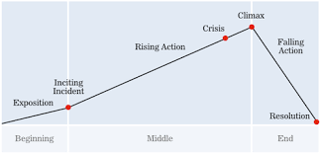
FRAMING THE NARRATIVE

Slide 41
FRAMING THE NARRATIVE
“KS” is essentially framed by one scene: the narrator and Kekoa’s reaction to the heartbreaking news that the program is closing down. The essay takes the reader to many places and informs them about a variety of different things. However, in that process, the narrator keeps returning to this pivotal scene, thus keeping readers grounded. Again, scenes are an important element of framing most essays. A travel writing piece for example, might begin with the narrator packing, follow them through some of the scenes on their voyage, and then end with the narrator unpacking and reflecting upon their journey.
Aside from solid scene construction—which is the most conventional way to frame a narrative—you could also be more creative. For example, maybe you frame the essay with any of the following:
A number of dated entries that shows the evolution of something.
A number of emails to and from characters within the story.
A number of pictures taken, each with their own unique anecdote that contributes to the larger narrative.
There are countless creative ways to frame a narrative!

Slide 42
EMBEDDING RESEARCH
It’s important that your essay makes a strong attempt to inform your readers about something. However, it’s also important to remember that you’re writing a narrative (a story). It’s important, then, to make sure that your informative writing is smoothly integrated and does not overpower the creative elements (plot, character, theme, setting, etc). For this reason, any research or informative writing should be carefully balanced with your creative writing conventions and/or succinctly embedded into your writing.
Although you should probably be using some research, it’s important to remember that you are not writing an English composition paper! Therefore, you are not using Modern Language Association (MLA) parenthetical citations for any quotes or statistics you use. Instead, you should attribute any of the information by embedding it into your writing.

Slide 43
EMBEDDING RESEARCH
ATTRIBUTION: MODERN LANGUAGE ASSOCIATION
After my conversation with Jen, I needed to get away from it all, so I set out to hike the Kuliouou Ridge Trail by myself. One of the problems with hiking alone is that “Statistically, you’re more than 11 times more likely to die while hiking alone than when you’re with a companion” (Anderson, 54).
ATTRIBUTION: CREATIVE NONFICTION
After my conversation with Jen, I needed to get away from it all, so I set out to hike the Kuliouou Ridge Trail by myself. As I set out on the trail, I began thinking about an article from Outside Magazine that I had recently read. Author Heather Anderson’s article, titled “Fatality on the Trail,” explained that “Statistically, you’re more than 11 times more likely to die while hiking alone than when you’re with a companion.”

Slide 44
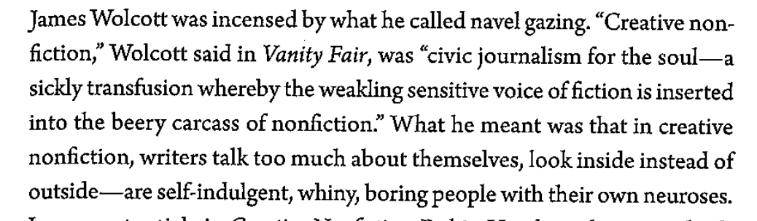
PAGE 57

Slide 45
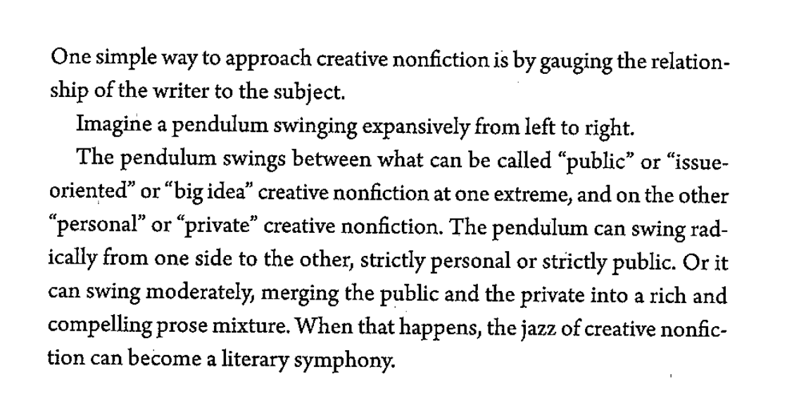
PAGE 55

