Slide 1
FUNDAMENTALS OF ACADEMIC WRITING
THESIS, TOPIC SENTENCES, ARGUMENT, FORMATTING, THE WRITING PROCESS, REVISION, BASIC GRAMMAR

Slide 2
WHAT IS A THESIS
There are many words for thesis: position, argument, stand, claim, premise.
A thesis is an ARGUMENT on a topic, one that uses evidence from the material you’ve read, not a SUMMARY of it.

Slide 3
A THESIS PROVIDES STRUCTURE FOR YOUR PAPER
The thesis should provide a structure for your argument.
A good thesis not only signals to the reader what your argument is, but how your argument will be presented.
In other words, your thesis sentence should either directly or indirectly suggest the structure of your argument to your reader.
Say, for example, that you are going to argue that “Globalization is important to understand for three important reasons: A, B, and C.”
In this case, the reader understands that you are going to have three important points to cover, and that these points will appear in a certain order.

Slide 4
A STRUCTURED THESIS
Canada is the best country in the world because it offers many great resources such as the following: free health care, high quality education, and well-organized cities.

Slide 5
WHERE IS MY THESIS LOCATED?
The thesis is located towards the very end of your opening paragraph.

Slide 6
HOW LONG SHOULD MY THESIS BE?
Your thesis does not have to be one sentence.
Your thesis can be multiple sentences.
The most important aspect of your thesis is that you’re introducing the reader to the different arguments that you’re making in the essay.

Slide 7
OPEN YOUR PAPER WITH A HOOK
Paragraph # 1 is the ONLY paragraph that begins with a quotation.
The quotation must be introduced by you, the writer, and must not appear as a drop quote.

Slide 8
WHAT IS A DROP QUOTE?
A drop quote is when you simply drop the quote into an essay without properly attributing the quote in your own words.
INCORRECT: “We cannot walk alone.” Martin Luther King Jr. once said this.
CORRECT: Martin Luther King Junior once said: “We cannot walk alone.”

Slide 9
THE MOST IMPORTANT ELEMENTS OF YOUR PAPER
1) The opening paragraph!
The opening paragraph is by far and wide the most important part of your paper. Unfortunately, it’s also the most difficult part to write. This paragraph is so important because it does the following: A) Engages the primary literature you’re using; B) Offers a thesis statement; C) Structures your paper by listing the sub points you’re using to prove your thesis.

Slide 10
MAPPING THE THESIS INTO TOPIC SENTENCES
THESIS:
Although digital technology has many benefits, it also harms people’s communication skills. In the classroom, these advancements create difficult barriers for today’s students to overcome. Furthermore, digital technology endangers people’s rights to privacy.
SUBTOPICS
Communication
Education
Rights to privacy

Slide 11
SAMPLE: A STRUCTURED EXPOSITORY ESSAY
PARAGRAPH #1: Introduction to Technology, Restak, and a thesis that introduces your three to four points of exploration.
PARAGRAPH #2: The overuse of technology for communication purposes creates a lack of empathy.
PARAGRAPH #3: Technology is negatively reshaping the way that today’s students learn.
PARAGRAPH #4: The increased self-promotion through technological platforms, such as social media networks, can lead to higher rates of narcissism
PARAGRAPH #5: Conclusion

Slide 12
THE MOST IMPORTANT ELEMENTS OF YOUR PAPER
2) Your topic sentences
Each paragraph after the opening (with the exception of your conclusion) must begin with a topic sentence that revisits one of the sub points listed in your opening paragraph.

Slide 13
MAPPING THE THESIS INTO TOPIC SENTENCES
THESIS:
Although digital technology has many benefits, it also harms people’s communication skills. In the classroom, these advancements create difficult barriers for today’s students to overcome. Furthermore, digital technology endangers people’s rights to privacy.
SUBTOPICS
Communication
Education
Rights to privacy

Slide 14
TOPIC SENTENCES SHOULD BE INTRODUCING ARGUMENTS AND THEREFORE THEY SHOULD BE OPINIONATED
Subtopic: Communication
TOPIC SENTENCE 1 (PARAGRAPH #2)
Digital technology is having a detrimental impact on the way that people communicate with one another in their daily interactions.

Slide 15
TOPIC SENTENCES SHOULD BE INTRODUCING ARGUMENTS AND THEREFORE THEY SHOULD BE OPINIONATED
Subtopic: Education
TOPIC SENTENCE 2 (PARAGRAPH #3)
Unfortunately, digital technology is creating problematic distractions for today’s students and harming their education.

Slide 16
TOPIC SENTENCES SHOULD BE INTRODUCING ARGUMENTS AND THEREFORE THEY SHOULD BE OPINIONATED
Subtopic: Rights to privacy
TOPIC SENTENCE 3 (PARAGRAPH #4)
Digital technology poses alarming threats for everyone’s personal right to privacy.

Slide 17
TIP: BEGIN ENTIRE ESSAY WITH A HOOK. USE A
Richard Restak, a Clinical Professor of Neurology at George Washington Hospital University, believes that, “Technology routinely places us in ambiguous time and place relationships” (340).

Slide 18
PAPER FORMAT
Name and date in upper left hand corner. Use the date that the paper is due, NOT the date that you wrote it!
The paper should have a creative title that is centered at the top of page #1
Rough draft should be a minimum of 600 words. PLEASE NOTE THAT I DO NOT COLLECT ROUGH DRAFTS.
Final draft must be a minimum of 750 words
Margins should be 1 inch all around
Font should be Times New Roman, font size 12
Lines should be double-spaced
Body of the paper should be aligned to the left
All paragraphs are indented
Each page should be numbered (1, 2, 3, etc.) on the upper right-hand corner. Your last name followed by the page #.
State the word count under the final paragraph of your paper.

Slide 19
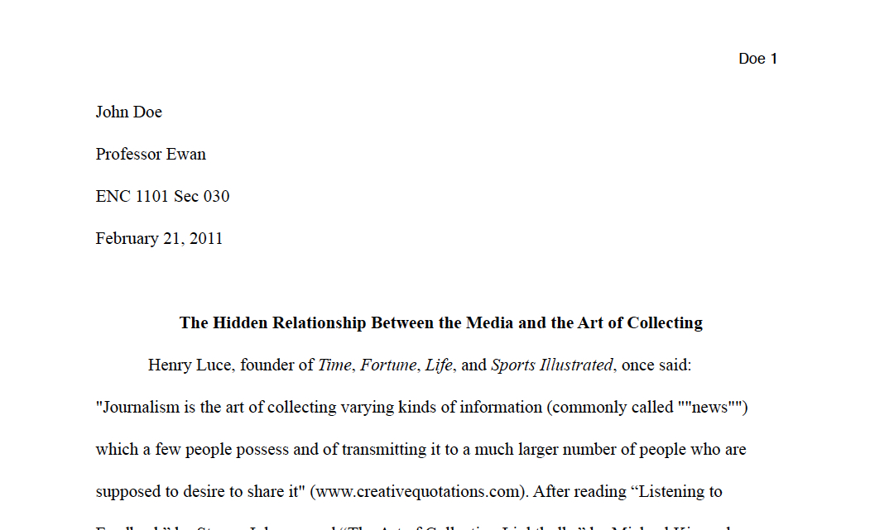

Slide 20
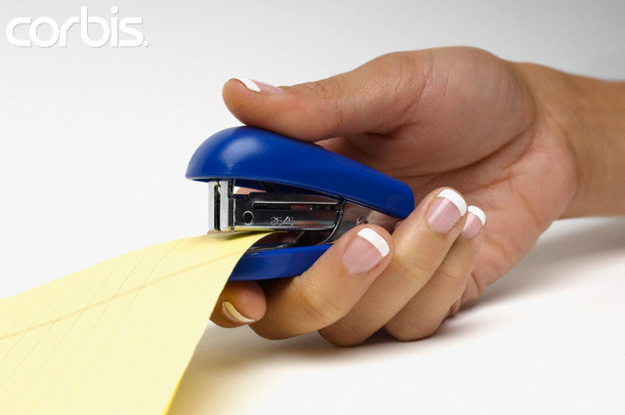

STAPLE YOUR PAPER
https://vimeo.com/51172321

Slide 21
THE WRITING PROCESS
5 Crucial Steps to Help You Succeed in Writing

Slide 22
STEP 1: PREWRITING
THINK
Decide on a topic to write about.·
Consider who will read or listen to your written work.
Brainstorm ideas about the subject.
List places where you can research information.
Do your research.

Slide 23
STEP 2: DRAFTING
WRITE
Put the information you researched into your own words.
Write sentences and paragraphs even if they are not perfect.
Read what you have written and judge if it says what you mean.
Show it to others and ask for suggestions.

Slide 24
STEP 3: REVISING
MAKE IT BETTER
Read what you have written again.
Think about what others said about it.
Rearrange words or sentences.
Take out or add parts.
Replace overused or unclear words.
Read your writing aloud to be sure it flows smoothly.

Slide 25
STEP 4: PROOFREADING
MAKE IT CORRECT
Be sure all sentences are complete.
Correct spelling, capitalization, and punctuation.·
Change words that are not used correctly.
Have someone check your work.
Recopy it correctly and neatly.

Slide 26
STEP 5: PUBLISHING
SHARE THE FINISHED PRODUCT
Read your writing aloud to a group.
Create a book of your work.
Send a copy to a friend or relative.
Put your writing on display.
Illustrate, perform, or set your creation to music.
TURN IT INTO YOUR PROFESSOR FOR A GRADE

Slide 27
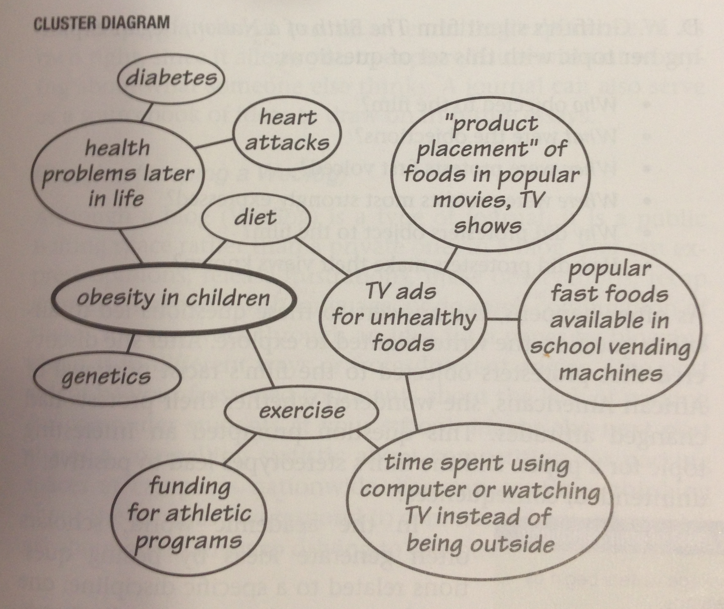
PREWRITING: CLUSTER DIAGRAM
TOPIC = OBESITY IN CHILDREN

Slide 28
ESSENTIAL WRITING SKILLS FOR PASSING THIS COURSE

Slide 29
Do not write in the second person point of view.
Translation: The word “you” should not appear in your essay. Why?
You can go your entire life without falling in love until you meet the right person and everything changes.
I had gone my entire life without falling in love until I met the right person and everything changed.

Slide 30
Do not write in the second person point of view.
Translation: The word “you” should not appear in your essay. Why?
-Prevents you from being hypothetical!
-Keeps the writing centered on the subject, which for the personal essay, is you, NOT me!
“You have no idea what it’s like to give birth!”
-Helps you stay in the same tense. For this essay, you are writing in the past tense

Slide 31
Stay in the same tense
About noon the sky darkened, a breeze sprang up, and a low rumble announces the approaching storm.
About noon the sky darkened, a breeze sprang up, and a low rumble announced the approaching storm.

Slide 32
SENTENCE STRUCTURE
Every sentence has a subject (the noun) and a predicate (the verb).
FIX THIS INTO ONE SENTENCE
My grandma and her beautiful ways. Her long hair. Her perfect smile. Her amazing cooking. Oh how I miss her home.

Slide 33
YOU MUST USE COMMAS
AND YOU MUST USE THEM CORRECTLY

Slide 34
What Does a Comma Signal?
A comma signals a pause. (It tells the reader to slow down briefly, but then keep going until the thought is completed.)
  Because I like grammar , I like this class.

Slide 35
Commas
The best way, maybe the only way, to detect where you need commas is to read your paper out loud, detect pauses in your syntax, and punctuate where necessary.
Commas are almost always best used in pairs.
State the subject, state something about the subject, and move on.
The state of Florida, with its incessant summer flat spells, is one of the worst states for surfing.

Slide 36
What is a comma splice?
A comma splice is a sentence error caused by putting just a poor, weak comma between two complete sentences.
    We all like grammar, we all love this class.

Slide 37
Correct comma splices using a coordinating conjunction
I want a raise I want more vacation days.
I want a raise, and I want more vacation days.
And, but, for, nor, or, so, and yet—these are the seven coordinating conjunctions.
I WOULD RATHER SEE YOU BEGIN A SENTENCE WITH A COORDINATING CONJUCTION THAN SEE A COMMA SPLICE!!

Slide 38
USE COLONS
Colons are best used to introduce a quote or a lists.
Judge Judy game me a menacing look: “Who the hell do you think you are?” she asked.
The things I miss about living in Hawaii are endless: big waves, waterfalls, luaus, emerald-topped mountains, fishing for my dinner, and even the traffic, as cars were always stopping along the highway to observe a breaching whale.

Slide 39
Semicolons
Unless you are 100% positive that you know how to use them, or unless Microsoft Word inserts them for you, avoid semicolons at all costs.

Slide 40
Possessives
When a noun is possessive, it gets an apostrophe.
My mother’s cooking
My best friend’s dog
The car’s engine
President Obama’s speech about Russia’s diplomatic efforts in Syria.

Slide 41
THERE, THEIR, THEY’RE
There are three different forms of the word “there.” Learn them, love them, live them!
There
Their
They’re

Slide 42
CONTRACTIONS
In academic writing, it’s best to get rid of your contractions and write them out. This improves the flow of the paper.
We’re = We are
They’re = They are
Isn’t = Is not

Slide 43
It’s vs its
It’s equals “it is”
Although the car is newer, it’s still a piece of junk.
Its is the possessive form of its
The state of Florida, with its incessant summer flat spells, is one of the worst states for surfing.

Slide 44
TIGHTEN UP
Good writing is tight writing. A good writer says as much as possible, with as few words as possible. Use an academic vocabulary. Words such as major, big, little, people, can all be replaced with a thesaurus.

Slide 45
HUH? (DON’T WRITE LIKE THIS)
Technology harms people’s ability to communicate. In today’s society, with how much time everyone spends texting instead of talking, this harms the way people connect with others. People spend so much time with technology that they don’t talk to one another anymore. Technology is part of the problem why people have trouble communicating. Social media and technology is inhibiting people from getting across to each other.

Slide 46
EVERY WORD: WRITE WITH A THESAURUS
When you use a thesaurus, you write better, you just do.
Johnson thinks feedback can be a problem for the media.
Problem: thesaurus results = noun1 they ran into a problem: difficulty, trouble, worry, complication, difficult situation; snag, hitch, drawback, stumbling block, obstacle, hurdle, hiccup, setback, catch; predicament, plight; misfortune, mishap, misadventure; dilemma, quandary; informal headache, nightmare.

Slide 47
EVERY WORD: WRITE WITH A THESAURUS AND MINIMZE
Johnson thinks feedback can be a problem for the media.
Johnson theorizes that feedback can be a quandary for the media.
Here, I’m including the word “that” because it is an antecedent that improves the flow of the sentence. But often, the word “that” is overused and usually unnecessary. The same is true for the word “major.”

Slide 48
STILL NOT FINISHED
Johnson theorizes that feedback can be a quandary for the media.
“can be a” must have a more scholarly, academic delivery mechanism.
Johnson theorizes that feedback presents a quandary for the media.

Slide 49
REANALYZE EVERY SENTENCE
Omit needless words. Vigorous writing is concise. A sentence should contain no unnecessary words, a paragraph no unnecessary sentences, for the same reason that a drawing should have no unnecessary lines and a machine no unnecessary parts.

Slide 50
RECAP
13th Grade Level Sentence
Johnson thinks feedback can be a problem for the media.
College Level Sentence
Johnson theorizes that feedback can be a quandary for the media.
A Level Sentence
Johnson theorizes that feedback presents a quandary for the media.

Slide 51
INTRODUCTORY CLAUSES
Steven Johnson, a writer for the New York Times, is an expert in contemporary media. Johnson theorizes that feedback presents a quandary for the media. Johnson has witnessed dramatic changes in the way media functions in today’s society.
USE COMMAS TO INTRODUCE A PERSON, A CONCEPT, AN IDEA, ANYTHING!
Introduce something, insert a comma
Quickly say something about what you’ve introduced, insert another comma
Continue your train of thought, insert a period.

Slide 52
DETECTING REDUNDANCY
BAD
Steven Johnson, a writer for the New York Times, is an expert in contemporary media. Johnson theorizes that feedback presents a quandary for the media. Johnson has witnessed dramatic changes in the way media functions in today’s society.

Slide 53
BETTER
Steven Johnson, a writer for the New York Times, is an expert in contemporary media. Johnson theorizes that feedback presents a quandary for today’s news networks. He has witnessed dramatic changes in how the press functions.

Slide 54
BEST
Steven Johnson, a writer for the New York Times, is an expert in contemporary media. Johnson theorizes that feedback presents a quandary for today’s news networks. He notices dramatic changes in the functionality of the press.

Slide 55
USE THE ACTIVE VOICE
At the heart of every good sentence is a strong, precise verb; the converse is true as well--at the core of most confusing, awkward, or wordy sentences lies a weak verb. Try to use the active voice whenever possible.

Slide 56
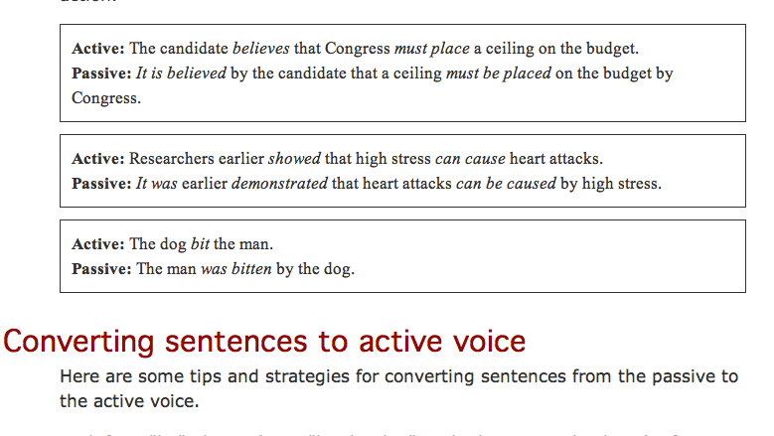
USE THE ACTIVE VOICE

Slide 57
CONVERT TO THE ACTIVE VOICE
“There is a considerable range of expertise demonstrated by the spam senders.”
“It was determined by the committee that the report was inconclusive.”
“We were invited by our neighbors to attend their party.”

Slide 58
USE THE ACTIVE VOICE
“The spam senders demonstrate a considerable range of expertise.”
“The committee determined that the report was inconclusive.”
“Our neighbors invited us to attend their party.”
Notes:
“The spam senders demonstrate a considerable range of expertise.”
“The committee determined that the report was inconclusive.”
“Our neighbors invited us to attend their party.”
“Groups help participants realize that others in the group share most of their problems and secrets.”

