Slide 1
INTRODUCTORY PARAGRAPH
It is true that the first impression—whether it’s a first meeting with a person or the first sentence of a paper—sets the stage for a lasting impression. The introductory paragraph of any paper, long or short, should start with a sentence that peaks the interest of readers. In a typical essay, that first sentence leads into two or three other statements that provide details about the writer's subject or process. All of these sentences build up to the essay's thesis statement.

Slide 2
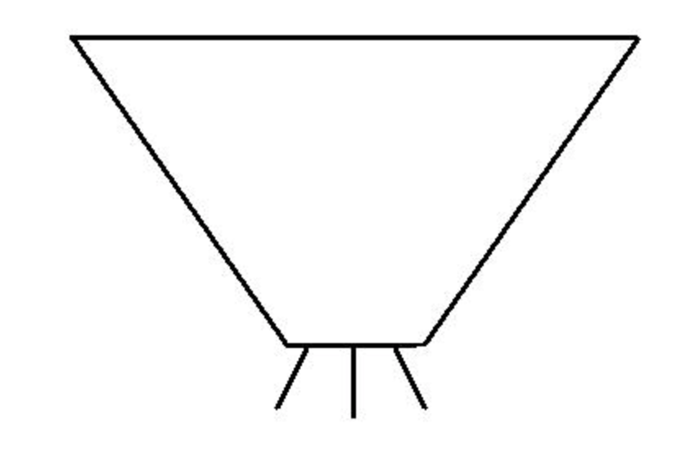
INTRODUCTORY PARAGRAPH

Slide 3
BEGIN WITH A HOOK!
A hook is an opening statement (which is usually the first sentence) in an essay that attempts to grab the reader’s attention so that they want to read on. It can be done by using a few different types of hooks, which are a question, quote, statistic, or anecdote. Be mindful that the hook has to be related to the overall topic of the paper. Here are a few examples of each type of hook.

Slide 4
HOOK = USE A QUOTE
Dr. Gary Small, a Professor of Psychiatry and Biobehavioral Sciences at the University of California at Los Angeles, explains the following: “We’re immersed it in. And it's changing so rapidly, we're just beginning to grasp what's happening (Dretzin).” Here, Small is discussing the drastic changes digital technology is imposing on today’s society.
“We’re immersed it in. And it's changing so rapidly,” explains Dr. Gary Small, a Professor of Psychiatry and Biobehavioral Sciences at the University of California at Los Angeles, “we're just beginning to grasp what's happening (Dretzin).” Here, Small is discussing the drastic changes digital technology is imposing on today’s society.

Slide 5
USE A QUOTE WITH A SHOCKING STATISTIC
It is beyond shocking that in today’s technologically driven world, most kids are “spending more than 50 hours a week with digital media” (Dretzin). Although there are many advantages to using technology so much, one has to wonder about some of the dangers associated with this phenomenon.

Slide 6
INTRODUCTORY PARAGRAPH EXAMPLE
In his article “Attention Deficit: the Brain Syndrome of our Era,” Richard Restak, a neurologist, mentions the fact that “technologically driven change in the brain is the biggest modification in the last 200,000 years” (333). He argues that modern technological advances have altered the brain at an unprecedented level. Ironically, although the aim of technology is to expand and evolve the human society into a much more advanced and privileged one, the aftermath can be detrimental to the users. Technology—despite having many significant purposes—causes a lack of focus, a key component in education. Additionally, it harms communication skills and makes people narcissistic.

Slide 7
INTRODUCTORY PARAGRAPH EXAMPLE
Douglas Rushkoff, a media theory professor at City University of New York, claims that “when you stand back and just look a while, it becomes clear that people will take almost any technology and use it to express themselves, to find other people, to remake the world on their own terms” (Dretzin). The integration of digital technology into society’s daily life is transparent with its use in education, business, and day-to-day life. However, the influence that these advancements have on communities is more destructive than they first may appear. Modern society mindlessly utilizes all aspects digital technology has to offer, deteriorating physical communication skills, presenting distractions in education, and perpetuating narcissism in many individuals.

Slide 8
THE CONCLUSION PARAGRAPH
The goal of your conclusion paragraph is to restate the thesis, summarize the essay's body, and leave readers with a final impression.

Slide 9
CONCLUSION PARAGRAPH EXAMPLE
All things considered, digital technology is growing and mankind is utilizing every feature to its full potential. However, where there is light, there must also be darkness. The benefits of digital advancements may shine in the spotlight, but the inconspicuous drawbacks are tremendous in the shadows of technology. Individuals do not realize the destructive features that accompany the use of electronics in contemporary society. Digital technology is decaying tangible communication skills, producing distractions in educational settings, and nourishing narcissism in individuals. In due course, it feels like mankind could lose the very skills that make them human.

