Slide 1
PAPER #3: Point of View
You may use third person point of view
3rd person POV = “he,” “she,” “they,” “people,” “society,” etc.
You may use first person point of view
1st person POV = “we,” “our,” “us,” “I,” “me,” etc.
You MAY NOT use second person POV
2nd person POV = “you,” “your,” “you’re” etc

Slide 2
PAPER #3: Research
Just like paper #2. you should be using RESEARCH in this essay!
Quality Sources
Scholarly Academic Articles from Library Database
Online Publications
Time
Chronicle of Higher Education
New York Times
Washington Post
The New Yorker
The Guardian
The Intercept
Mother Jones
The New Republic
The Nation
Honolulu Civil Beat
Honolulu Star Advertiser
Acceptable Sources
Website from other legitimate nonprofit organizations focus
Primary Research (for A grade option)
Interviews
Surveys/Polls (quantitative and qualitative data)
Original Photographs
DO NOT USE: Wikipedia, Dictionaries, Blogs, Listiciles, Social Media Posts, etc.

Slide 3
INTRODUCTORY PARAGRAPH:
THE PROBLEM ESSAY
Begin the entire essay with a shocking quote or statistic (be sure to cite your source).
State the name of your nonprofit organization and your mission statement.
For your thesis, make a broad and hyperbolic statement about the problem (use pathos).
Identify a minimum of three specific aspects of the problem that you plan to discuss in your essay.

Slide 4
INTRODUCTORY PARAGRAPH:
THE SOLUTION ESSAY
Begin the entire essay with a shocking quote or statistic (be sure to cite your source).
State the name of your nonprofit organization and your mission statement.
For your thesis, make a broad and hyperbolic statement about the importance of addressing this problem (use pathos).
Identify a minimum of three tactics that your NPO is using to address the problem.

Slide 5
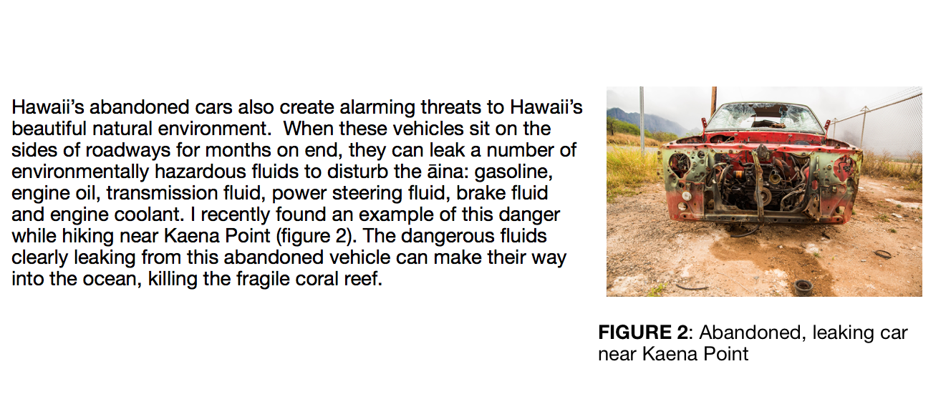
REFERENCING VISUAL EVIDENCE
You must also use original pictures in your essays. It’s easy to do a reverse image search to find out where you got your pictures.
You do not need to do a works cited entry for visual evidence.

Slide 6
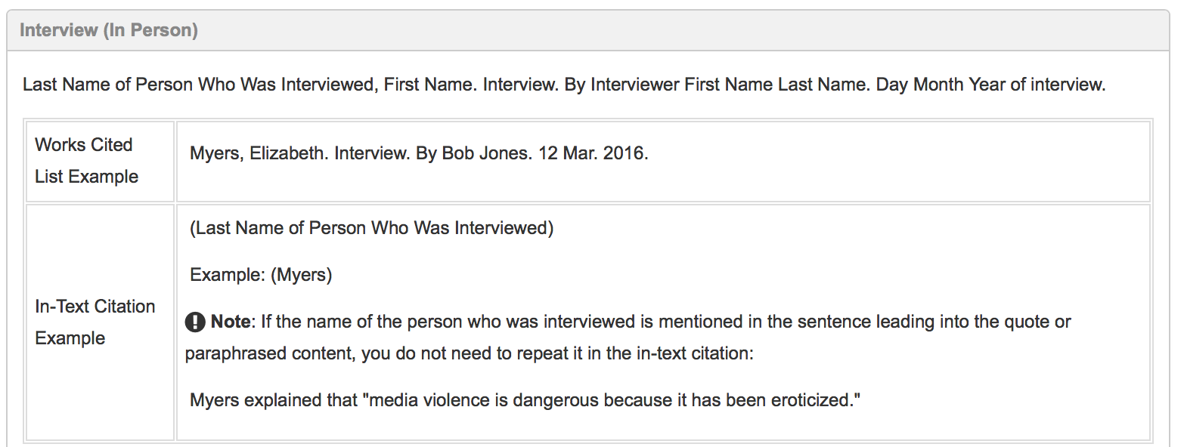
REFERENCING PERSONAL INTERVIEWS

Slide 7
REFERENCING SURVEYS
The number of diabetes cases in Hawaii indicates a genuine epidemic. I created a survey titled “Diabetes in Hawaii” using Google Forms. I distributed the survey to a total of nineteen people, most of which are friends and family. The youngest person surveyed was 14 and the oldest was 82. In all, I found that 84% of the people I surveyed knew someone with diabetes. In fact, when asked to explain this, one responded stated the following: “Here in Hawaii, nearly everyone knows someone suffering from diabetes.” The quantitative and qualitative data I collected underscores that the people in Hawaii are…
If you conduct a survey, you will be required to submit the spreadsheet containing all of your data with your final paper.

Slide 8
TIME MANAGEMENT
SHOULD BE FINISHED
Decide on topic and receive approval
Decide upon paper topics
Create a name for your NPO
Create a slogan for your NPO
Draft a mission statement for your NPO
Create a Gmail account for your NPO with shared password (for creating social media accounts)
Create a website account for your NPO with shared password (I recommend WIX)
SHOULD BE STARTED ON
Create Logo
Create the Home Page
Create the About Us Page
Create the Support Us Page
Create the Contact Us Page
Create Social Media Page (and post all of the group’s advertisements)

